Slide 1


Introduction to BlockChain and CryptoCurrency
Lecture # 1:Origins of Blockchain Technology

Slide 2
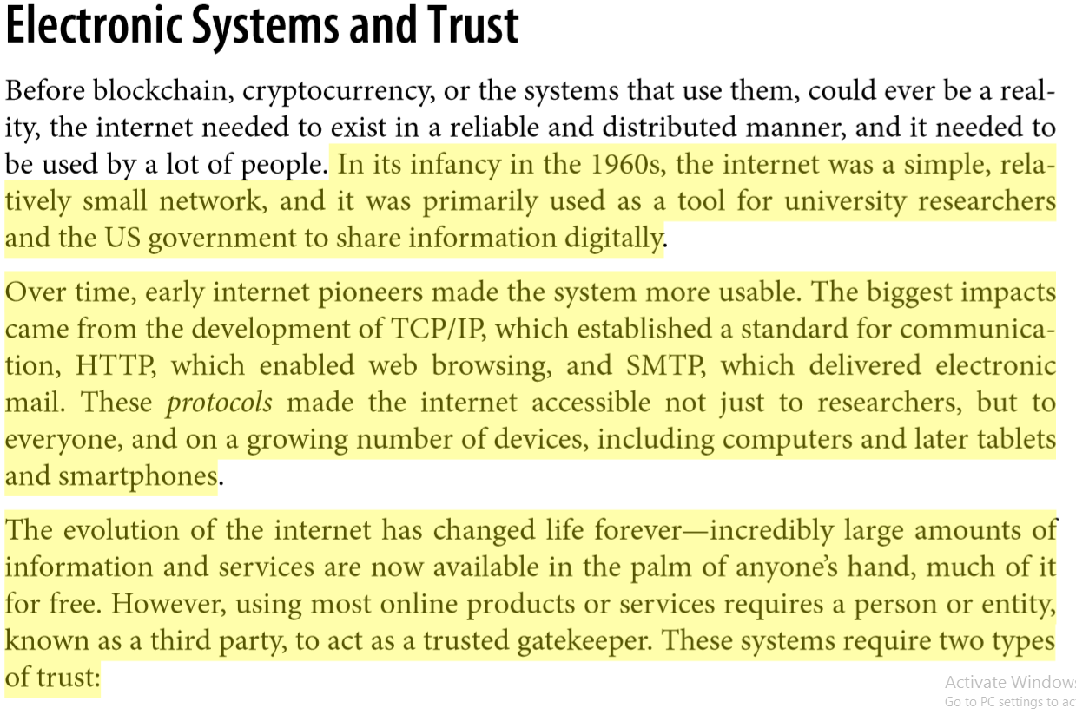

Slide 3
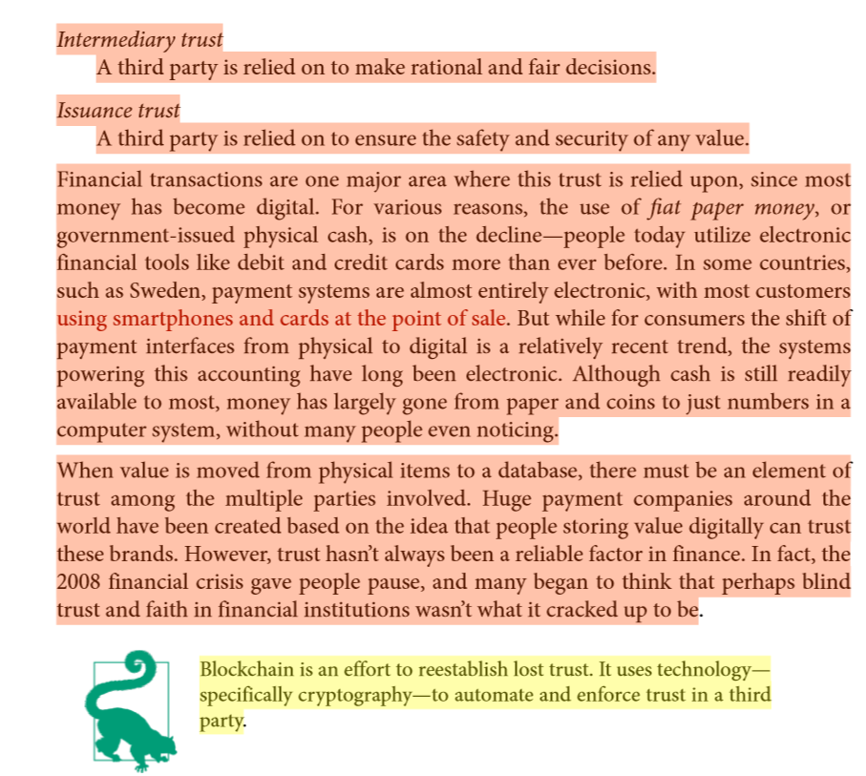

Slide 4
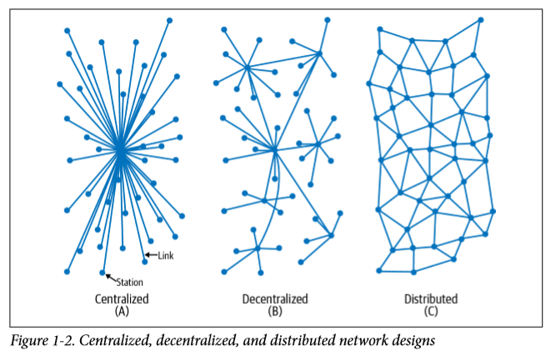
Distributed Versus Centralized Versus Decentralized

Slide 5
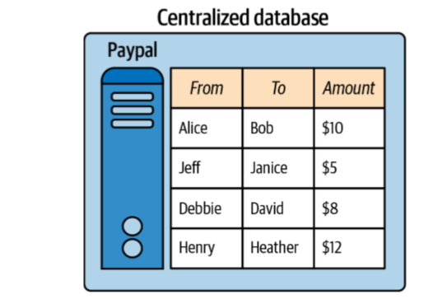
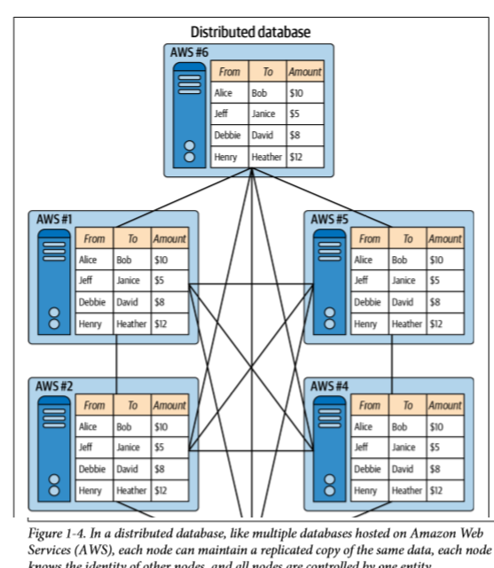

Slide 6
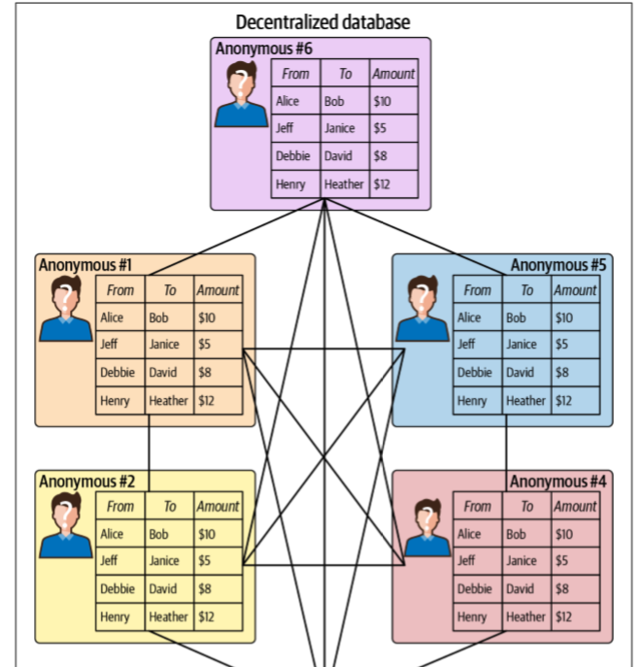

Slide 7
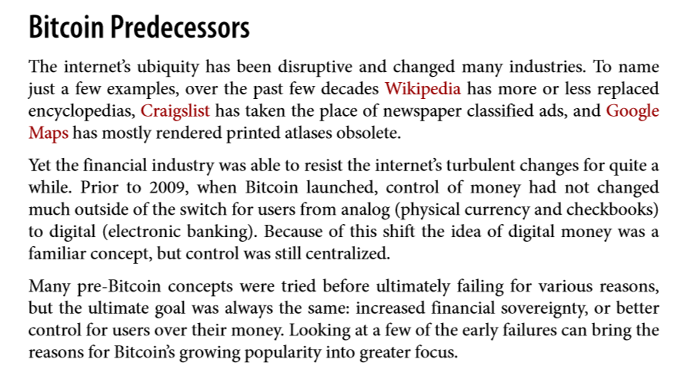

Slide 8
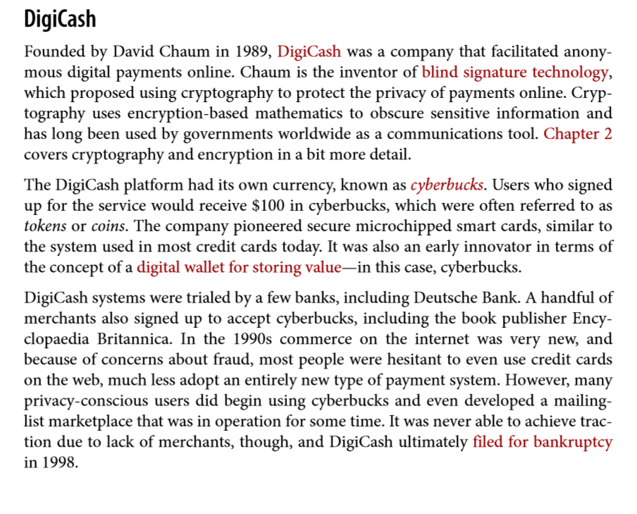

Slide 9
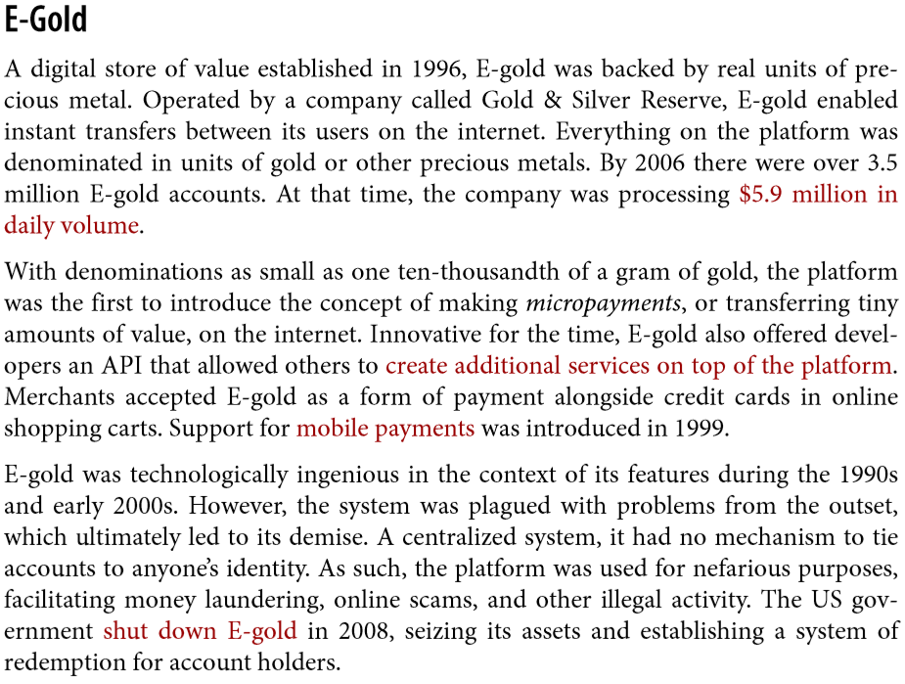

Slide 10
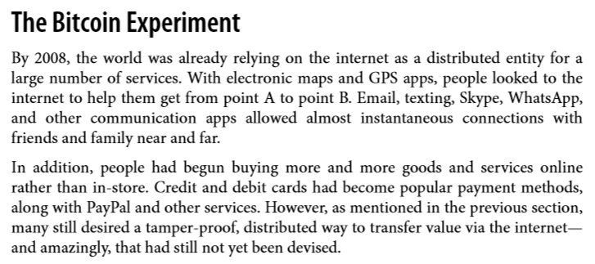
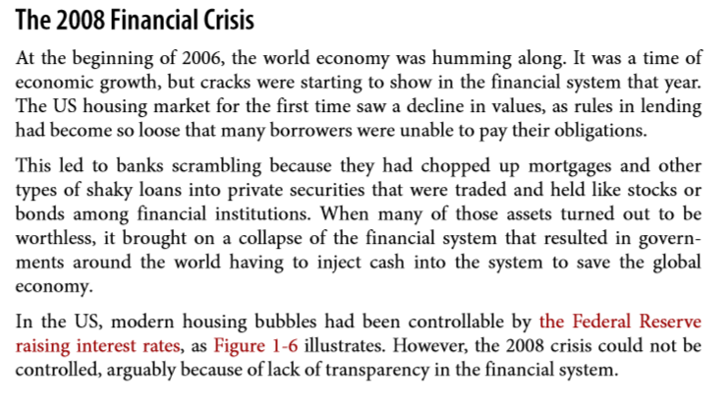

Slide 11
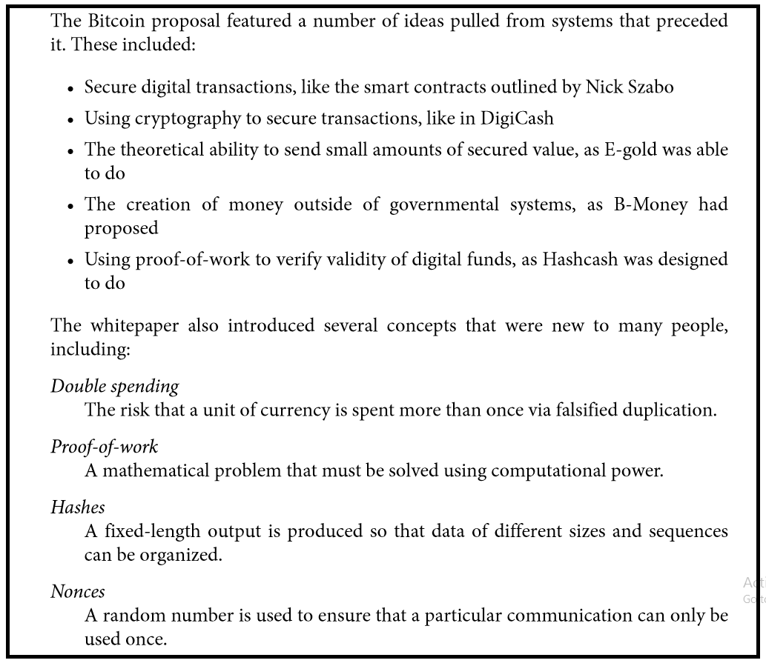

Slide 12
Acknowledgements
Material in this lecture are taken from the slides prepared by:
Prof. Dr. Konrad Rieck (Uni-Göttingen)
Satoshi Nakamoto, Bitcoin: A Peer-to-Peer Electronic Cash System, 2008
https://twitter.com/savjee
Dan Finlay https://github.com/MetaMask/IPFS-Ethereum-Hackathon
Edureka.com
Prof. Arvind Narayanan — Princeton University

Slide 13
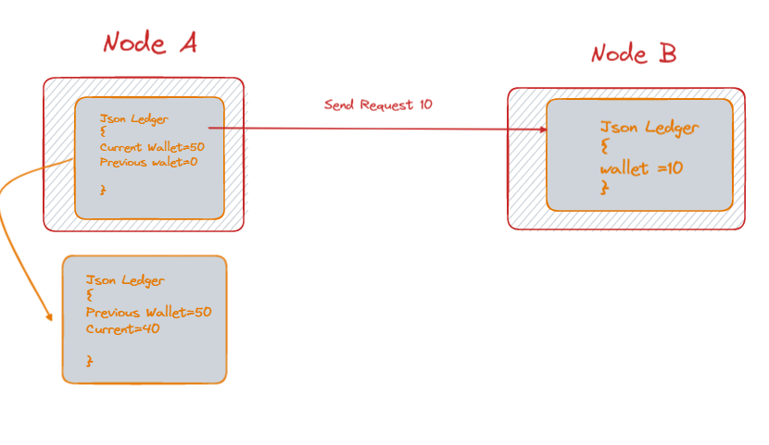
Lecture 2 Lab-1 Discussion
1. Create a client-server program in which message recording is maintained at each end through Json Dictionary mechanism. 2.Implement a Function of transaction workflow at Both End

